Slide 1
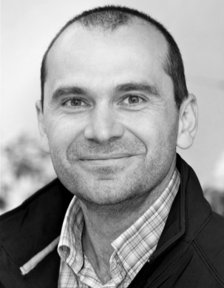
IoT Hackathon Berlin
Robert Eichenseer

Slide 2
How do you define IoT?
The “Internet Of Things” … ... is neither really about “Things” … … nor really about “The Internet” … … its about creating systems … … that make our daily lives better … … safer, more reliable, more efficient … … and more fun! *
* Clemens Vasters; Architect; Microsoft Azure

Slide 3
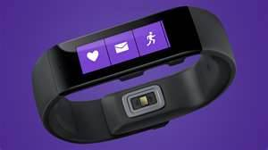
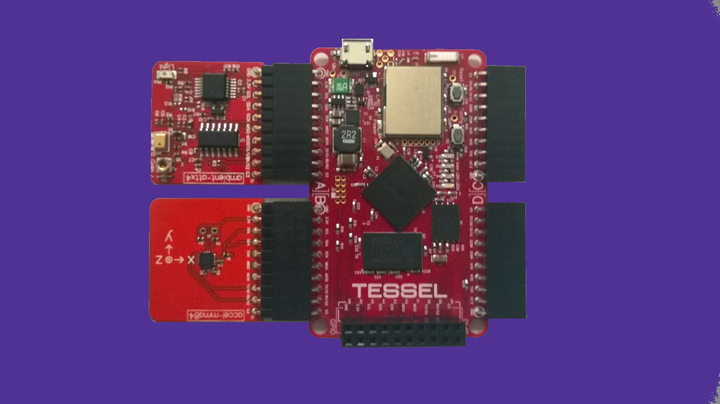
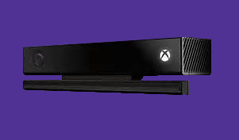
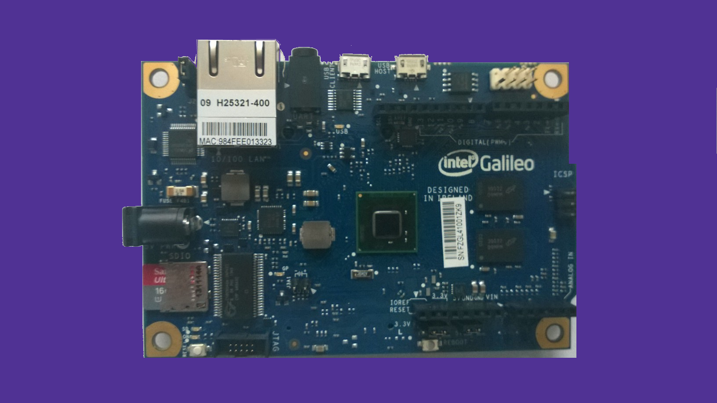
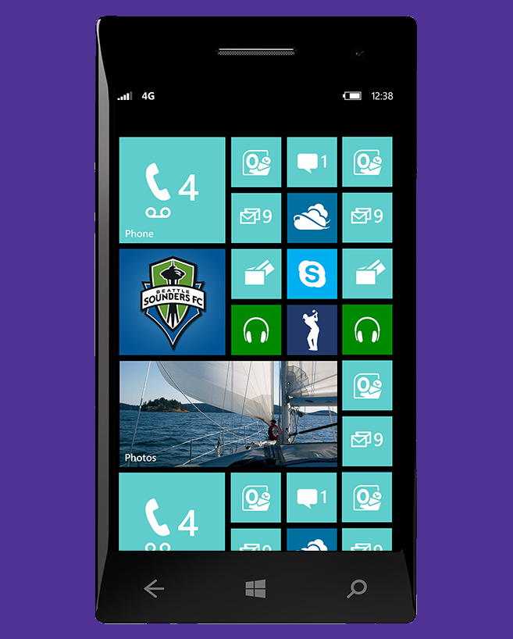
Smart Gadgets / Devices?

Slide 4
Patients
Smart Health-care
Smart Systems?
Manufacturing Integration and Automation
Clinics
Smart Pro Services
Remote Servicing
Mobile Care
Hospitals
Cars
Aircraft
Smart Factory
Fire
Nursing Homes
Smart Mobility
Pollution Control
Traffic
Buses
Emergency
Smart Cities
Renewables
Trains
Bikes
Predictive and Reactive Maintenance
Water
Smart Energy
Public
Safety
Oil/Gas/Coal Recovery and Distribution
Vessels
Trucks
Waste
Law Enforcement
Grid
Letters
Games
Hotels
Automation
Packages
Smart Logistics
Events
Smart Entertain-ment
Smart Building Home
Fuel Stations
Smart Retail
Lighting
Containers
Sports
Comfort
Points of Sale
Tanks
Bulkware
Streaming
Security
Safety
Television
Restaurants

Slide 5
Manufacturing Demo
IoT Showcase

Slide 6
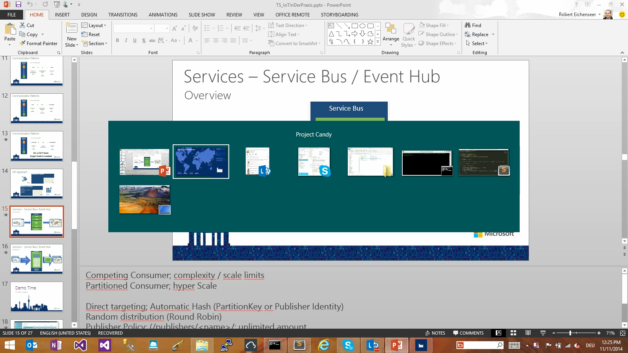

Slide 7
Similarities?
What is common in all scenarios

Slide 8
Communication Patterns
Telemetry
Ingest
That‘s easy …
Ingest rate
Storage
Security
…
That‘s not so easy …
Security
Latency
…
Command

Slide 9


MS Approach
Software as a Service
Storage
Service Bus / EventHub
Compute
Platform as a Service
Analytics (NRT, HD-Insight)
…
Audience:
LOB IT
Enterprise
System Integrator
SaaS
Audience:
Developer
ISV
PaaS

Slide 10
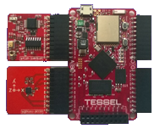
Azure Services / Building Blocks
Data Storage
Azure Storage
Telemetry
„The unlimited
hard disk“

Slide 11
Azure Services / Building Blocks
Storage / The „unlimited“ business hard disk
Local Zone Geo Redundant
Site A
Site A
Site B
Site A
Site B
Go to the Tessel Lab

Slide 12
Azure Services / Building Blocks
Data Storage / No SQL Data Store
Azure Table Storage
Telemetry
„The highly scalable
No SQL Data Store“

Slide 13
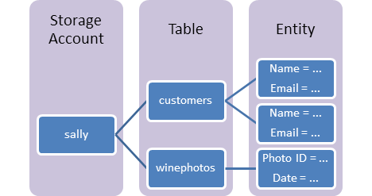
Azure Services / Building Blocks
Table Storage / The No Sql data store
Go to the Tessel Lab

Slide 14
Azure Services / Building Blocks
Compute
Azure Web Site
Telemetry
Azure Mobile Service

Slide 15
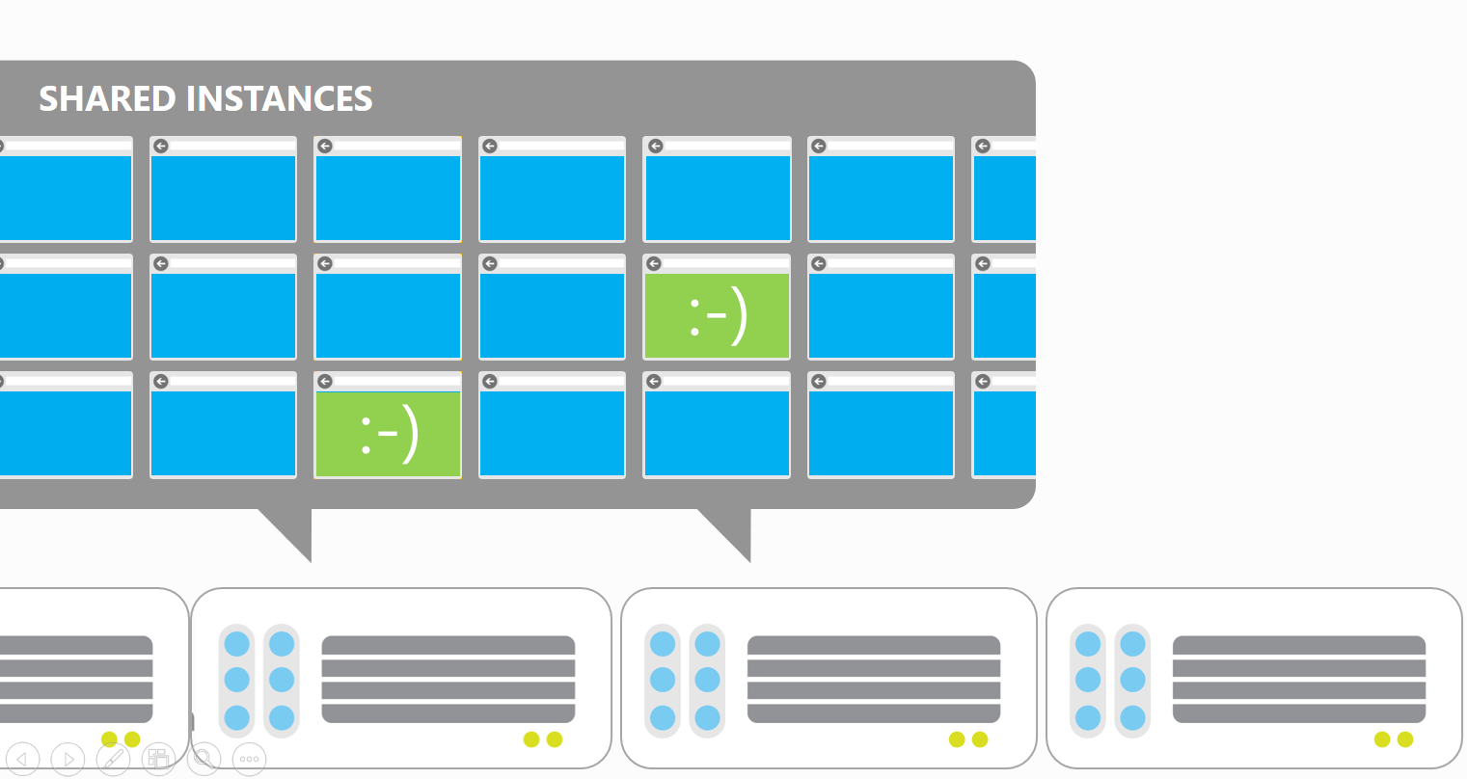
Azure Services / Building Blocks
Compute – WebSite
Give us your Code! We do the rest
Go to the Tessel Lab

Slide 16

Azure Services / Building Blocks
Compute – Mobile Services
Auth
Server Logic
Notifications
Logging & Diag
Build a cloud backend in minutes with no hassles, no deployments, no fear
Data
Scheduler
Scale
Go to the Tessel Lab

Slide 17
Azure Services / Building Blocks
Async Messaging with Service Bus
Subscriber
Telemetry
Azure Service Bus
Devices
Go to the Tessel Lab

Slide 18
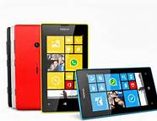
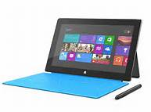

Azure Services / Building Blocks
Async Messaging with Notification Hubs
Telemetry
Notification Hubs
Devices
Go to the Tessel Lab

Slide 19
There‘s still a challenge!

Slide 20
Communication Patterns
Telemetry
Ingest
Let‘s do the math …
6
machines
X
20
sensors / machine
=
120
sensors
/
production line

Slide 21
Communication Patterns
Telemetry
Ingest
Let‘s do the math …
120
sensors /
production line
X
4
production lines
/
plant
=
480
sensors
/
plant

Slide 22
Communication Patterns
Telemetry
Ingest
Let‘s do the math …
480
sensors
/
plant
X
60
telemetry ingests
/
minute
=
1,728,000
ingests
/
hour

Slide 23
Communication Patterns
Telemetry
Ingest
Let‘s do the math …
1,728,000
ingests
/
hour
X
50
e.g. customers
=
86,400,000
ingests
/
hour
On a 24/7 basis

Slide 24
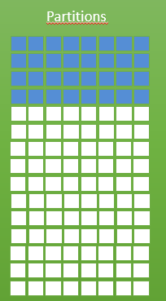
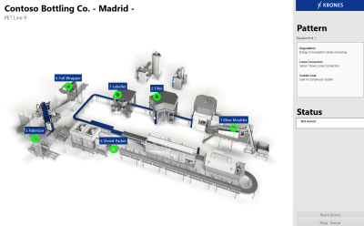
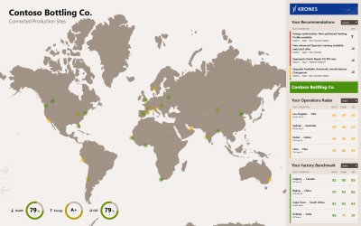
Services – Service Bus / Event Hub
Partitions
Service Bus
Event Hub
Production Line(s)
Interactive Dashboard(s)
Reader 1
Reader 2
Reader 3
….
Consumer Group
Reader 1
Reader 2
Reader 3
….
* 1 Mio Producers
* 1 GB/sec aggregate
per EventHub
Go to the Tessel Lab
Notes:
Competing Consumer; complexity / scale limits
Partitioned Consumer; hyper Scale
Direct targeting; Automatic Hash (PartitionKey or Publisher Identity)
Random distribution (Round Robin)
Publisher Policy: (/publishers/<name>/; unlimited amount
Cursor -> maintained by clients

Slide 25
Azure Services / Building Blocks
Other Services Data
Relational (as a Service / on IaaS)
NoSql (as a Service / on IaaS)

Slide 26
Azure Services / Building Blocks
Analytics
Azure Stream Analytics (Inflight Data)
HD-Insight / Storm (Batch / Inflight Data)
Azure Machine Learning
Azure Search
MS SQL Server
Power BI

Slide 27
Out of the Box
Nitrogen.IO
Open Source
Plumbing is done for you
Go Get It
Microsoft SaaS Solution
End-To-End solution

Slide 28
One thing left ….
!! Happy Hacking !!

Slide 29
Vielen Dank

